Slide 1

STRESS DETECTION IN IT PROFESSIONAL BY IMAGE PROCESSING
PRESENTED BY: GUIDED BY:
G.SAI RAM S.VIJAYALAXMI
H.NO:2129-22-862-060 ASSOCIATE PROFESSOR

Slide 2
ABSTRACT
The main conception of this project is to descry stress in the IT professionals with the help of Deep literacy and Image processing ways. This project is an upgraded interpretation of the old stress discovery systems which barred the live discovery and the particular comforting but this project comprises of live discovery and periodic analysis of workers and detecting physical as well as internal stress situations in his/ her by furnishing them with proper remedies for managing stress by furnishing check form periodically. This project substantially focuses on managing stress and making the working terrain healthy and robotic for the workers and to get the stylish out of them during working hours.in this when we detected different type behaviors of human being the person is in abnormal behavior like stress mood then we can control the person with smooth music.

Slide 3

INTRODUCTION
With the advent of modern technology our desires went high and it binds no bounds. In the present era a huge research work is going on in the field of digital image and image processing. Image Processing is a vast area of research in present day world and its applications are very widespread. Image processing is the field of signal processing where both the input and output signals are images. One of the most important applications of Image processing is Facial expression recognition. Our person behavior is revealed by the expressions in our face. Facial Expressions plays an important role in interpersonal communication. Facial expression is a non verbal scientific gesture which gets expressed in our face based as per our person behaviors. Automatic recognition of facial expression plays an important role in artificial intelligence and robotics and thus it is a need of the generation. Some application related to this includes Personal identification and Access control, Videophone and Teleconferencing, Forensic application, Human-Computer Interaction, Automated Surveillance, Cosmetology and so on. The objective of this project is to develop Automatic Facial Expression Recognition System which can take human facial images containing some expression as input and recognize and classify it into seven different expression. We should the find stress on it professionals.

Slide 4
EXISTING SYSTEM
The study of face based and its features is an active research area from past few decades. Pose variation, illumination conditions, bad lighting etc., are still challenging factors faced by all algorithms. Face based recognition and person behavior detection system are the major applications of recognition system, in which many algorithms have tried to solve these problems.
Principal Component Analysis
Geometric methods
Support vector machine.
Drawbacks
Low discriminatory power and high computational load
In geometric based methods, the geometric features like distance between speech signals.

Slide 5
PROPOSING SYSTEM
Proposed method
Pre-process
Deep learning
Human Behavior model
Feature extraction
ADVANTAGE:
Can relief the people from abnormal situations
More accurate results
Training of features are easy

Slide 6
REQUIREMENTS
Hardware requirement:
Hard Disk Drive=1Terabite
Software requirement
Python ,
anaconda navigator

Slide 7
USE CASE DIAGRAM
Data collection
Data
Feature extraction
Train and test
user
System
Apply
Find the accuracy
Result

Slide 8
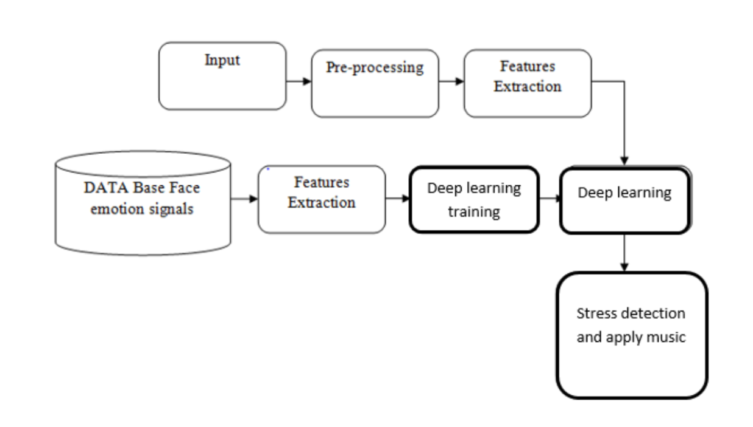
BLOCK DIAGRAM

Slide 9
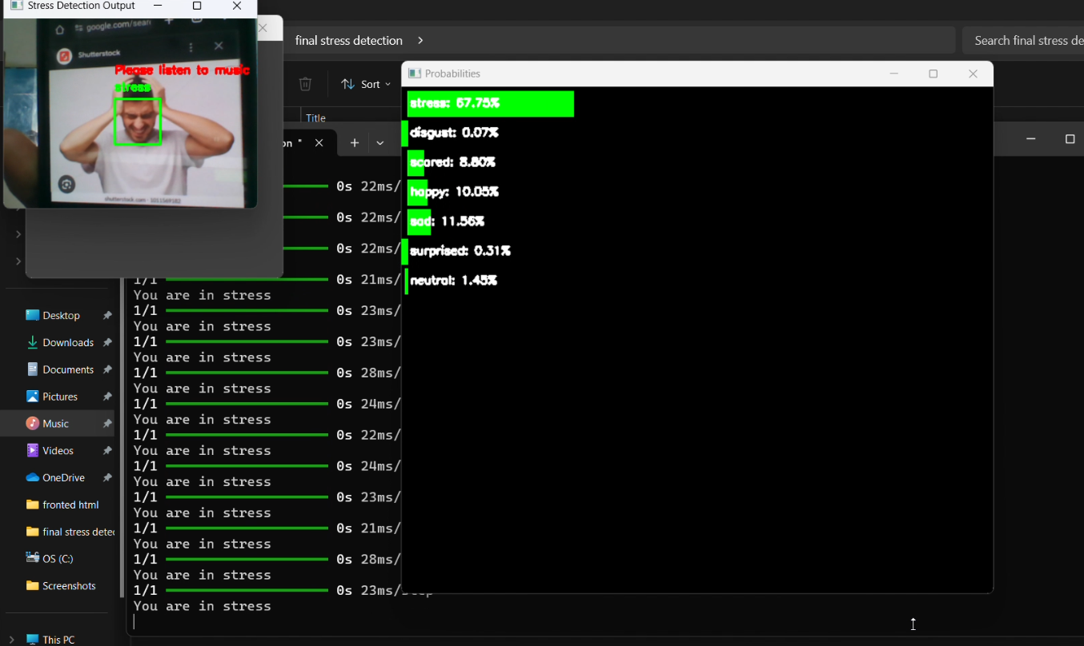
OUTPUT

Slide 10
CONCLUSION
The main conception of this project is to findout stress in human beings with the help of image processing.

Slide 11
THANK YOU

